Slide 1
Introduction to Machine Learning – Linear Regression
Dr. Ab Mosca (they/them)
Slides based off slides courtesy of Jordan Crouser (https://jcrouser.github.io/)

Slide 2
Reminder!
First homework is out today!
Homework and quizzes are week long assignments; expect to spend 5-7 hours on then (this is standard for a college class)
Chapter 2.3 in the textbook has refreshers for R and Python

Slide 3
Plan for Today
Introduction to Linear Regression:
Simple linear regression
Multiple linear regression

Slide 4
Warm Up
Variance: the amount the model would change if we had different training data
Bias: the error introduced by approximating a complex phenomenon using a simple model
In general, more flexible methods have higher variance and lower bias
Less flexible
More flexible
Low variance
High variance
High bias
Low bias

Slide 5
Warm Up
Practice: Work with a small group. Sketch your own example of a more and less flexible regression.
Variance: the amount the model would change if we had different training data
Bias: the error introduced by approximating a complex phenomenon using a simple model
In general, more flexible methods have higher variance and lower bias
Less flexible
More flexible
Low variance
High variance
High bias
Low bias

Slide 6

Running example: advertising

Slide 7



Last year’s advertising budget
Sales (in 1000s of units sold)
Sales (in 1000s of units sold)
Sales (in 1000s of units sold)
Budget (in $1,000s)
Budget (in $1,000s)
Budget (in $1,000s)

Slide 8


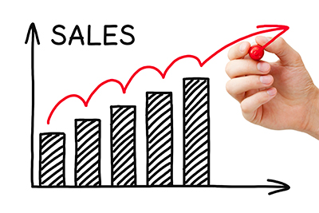
Your task

Slide 9
Questions you might ask
Is there a relationship between budget and sales?

Slide 10
Questions you might ask
Is there a relationship between budget and sales?
How strong is the relationship?

Slide 11
Questions you might ask
Is there a relationship between budget and sales?
How strong is the relationship?
Which media contribute to sales?

Slide 12
Questions you might ask
Is there a relationship between budget and sales?
How strong is the relationship?
Which media contribute to sales?
How accurately can we estimate the effect?

Slide 13
Questions you might ask
Is there a relationship between budget and sales?
How strong is the relationship?
Which media contribute to sales?
How accurately can we estimate the effect?
How accurately can we predict future sales?

Slide 14
Questions you might ask
Is there a relationship between budget and sales?
How strong is the relationship?
Which media contribute to sales?
How accurately can we estimate the effect?
How accurately can we predict future sales?
Is the relationship linear?

Slide 15
Questions you might ask
Is there a relationship between budget and sales?
How strong is the relationship?
Which media contribute to sales?
How accurately can we estimate the effect?
How accurately can we predict future sales?
Is the relationship linear?
Is there synergy among the advertising media?

Slide 16

Questions you might ask
Is there a relationship between budget and sales?
How strong is the relationship?
Which media contribute to sales?
How accurately can we estimate the effect?
How accurately can we predict future sales?
Is the relationship linear?
Is there synergy among the advertising media?
Linear Regression

Slide 17
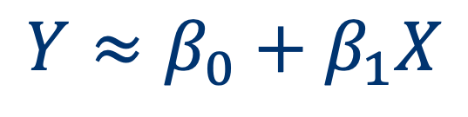

Simple linear regression
Straightforward approach for predicting a quantitative response on the basis of a single predictor
Assumption: there is a (roughly) linear relationship between X (the predictor) and Y (the response)
“intercept”
“slope”
the
response
$$Y≈β_{0}+β_{1}X$$
is approximately
modeled as
a linear function
of the predictor
sales $≈β_{0}+β_{1}× \text{TV}$

Slide 18

Simple linear regression
Reality: $β_{0}$ and $β_{1}$ are unknown
What we do know:
Goal: find estimated coefficients ${\hat{β}}_{0}$ and ${\hat{β}}_{1}$ such that
$$\left(x_{1},y_{1}\right), \left(x_{2},y_{2}\right), …, \left(x_{n},y_{n}\right)$$
$$y_{i}≈{\hat{β}}_{0}+{\hat{β}}_{1}x_{i}$$
Notes:
In practice: coefficients are unknown
Before we can use the linear model to predict future response values, we need to estimate them from the data:
Our goal: find estimated coefficients and so that

Slide 19
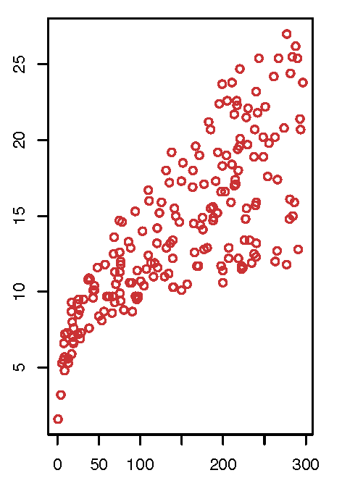


Simple linear regression
$$β_{0}$$
$$β_{1}$$
minimizes
RSS
“pretty close”
(other ways in Ch. 6)
Notes:
residual sum of squares

Slide 20
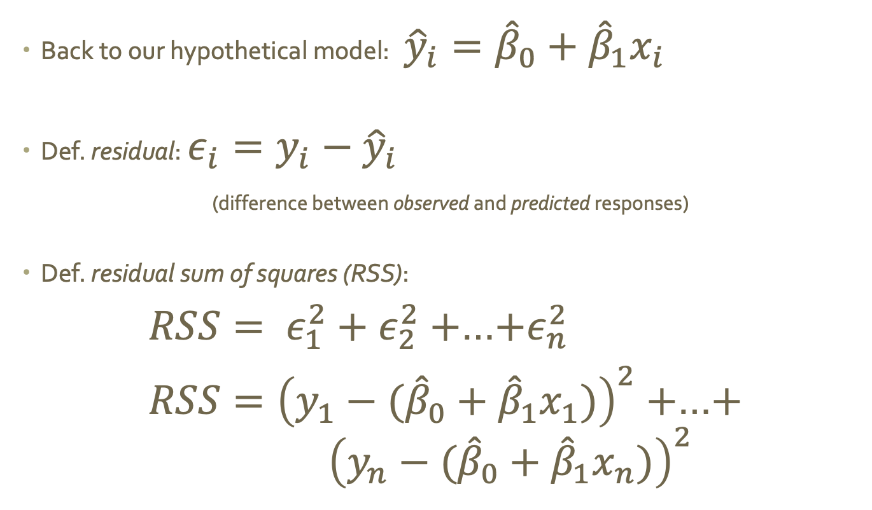
Def. residuals and RSS
Back to our hypothetical model: ${\hat{y}}_{i}={\hat{β}}_{0}+{\hat{β}}_{1}x_{i}$
Def. residual: $ε_{i}=y_{i}−{\hat{y}}_{i}$
(difference between observed and predicted responses)
Def. residual sum of squares (RSS):
$RSS= ε_{1}^{2}+ε_{2}^{2}+$…$+ε_{n}^{2}$
$RSS={\left(y_{1}−({\hat{β}}_{0}+{\hat{β}}_{1}x_{1})\right)}^{2}+$…$+$
$${ \left(y_{n}−({\hat{β}}_{0}+{\hat{β}}_{1}x_{n})\right)}^{2}$$

Slide 21
Minimizing RSS: least squares
Goal: ${\hat{β}}_{0}$ and ${\hat{β}}_{1}$that minimize RSS
Dusting off our calculus (or looking it up), minimizers are:
${\hat{β}}_{1}=\frac{\sum_{i=1}^{n}{\left(x_{i}−\overline{x}\right)\left(y_{i}−\overline{y}\right)}}{\sum_{i=1}^{n}{{\left(x_{i}−\overline{x}\right)}^{2}}}$ and ${\hat{β}}_{0}=\overline{y}−{\hat{β}}_{1}\overline{x}$
where $\overline{x}$and $\overline{y}$are the mean values of the sample

Slide 22
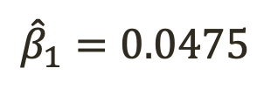
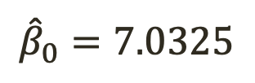
Advertising example
$${\hat{β}}_{0}=7.0325$$
$${\hat{β}}_{1}=0.0475$$
We’d expect to
sell about 7,033 units
without advertising
Every additional $1,000 $≈$47.5 additional units sold

Slide 23
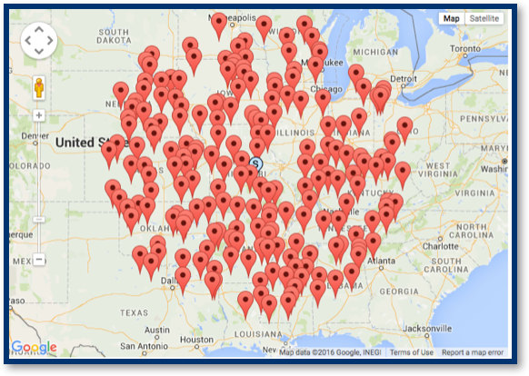
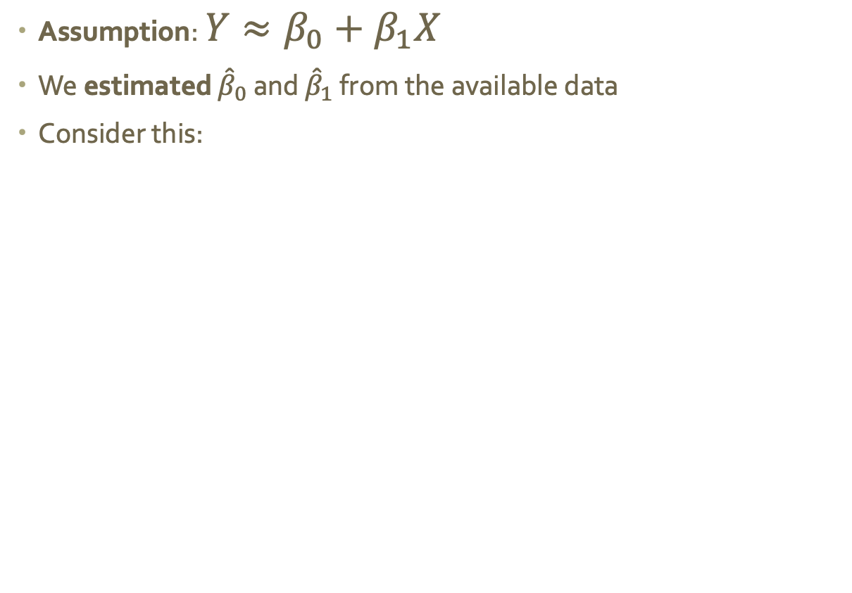
How good is this estimate?
Assumption: $Y≈β_{0}+β_{1}X$
We estimated ${\hat{β}}_{0}$ and ${\hat{β}}_{1}$ from the available data
Consider this:
Notes:
Different sets of observations will produce different estimated coefficients
Avg(huge number of samples) → perfect!
Least-squares is an unbiased estimator: i.e. doesn’t systematically over- or under-estimate
In reality, we usually don’t have a huge number of sample to average over… but we still want to be able to predict
So how close are our estimated parameters?

Slide 24
Standard error
Idea: borrow the concept of standard error (SE):
$$Var\left(\hat{μ}\right)=SE{\left(\hat{μ}\right)}^{2}=\frac{σ^{2}}{n}$$
$σ$ is the standard deviation of the population
$n$ is the number of samples
Note: the error gets smaller as the sample size increases

Slide 25
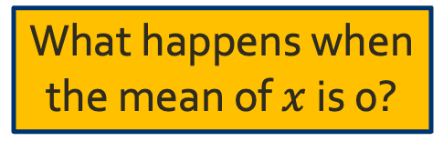

Standard error of ${\hat{β}}_{1}$, ${\hat{β}}_{0}$
Idea: use the standard deviation of $ε$ for $σ$ (why?)
Start with the slope:
$${SE\left({\hat{β}}_{1}\right)}^{2}=\frac{σ^{2}}{\sum_{i=1}^{n}{{\left(x_{i }−\overline{x}\right)}^{2}}}$$
And now the intercept:
$${SE\left({\hat{β}}_{0}\right)}^{2}=σ^{2}\left[\frac{1}{n}+\frac{{\overline{x}}^{2}}{\sum_{i=1}^{n}{{\left(x_{i }−\overline{x}\right)}^{2}}}\right]$$
What happens
as $x$ spreads out?
What happens when
the mean of $x$ is 0?

Slide 26
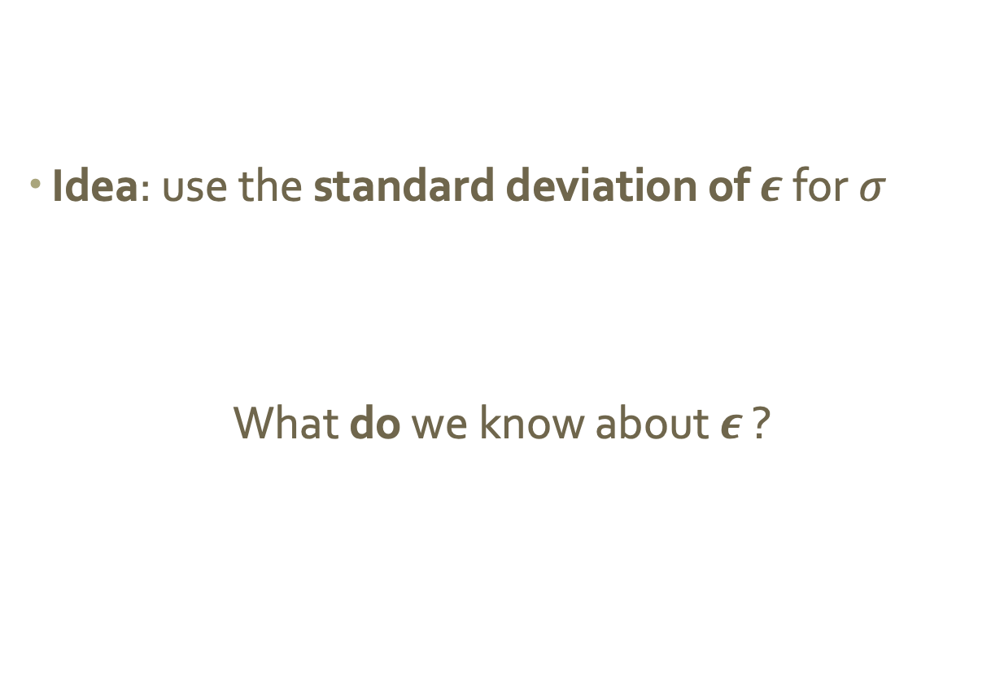
Just one problem…
Idea: use the standard deviation of $ε$ for $σ$
What do we know about $ε$ ?
usually don’t have this information

Slide 27
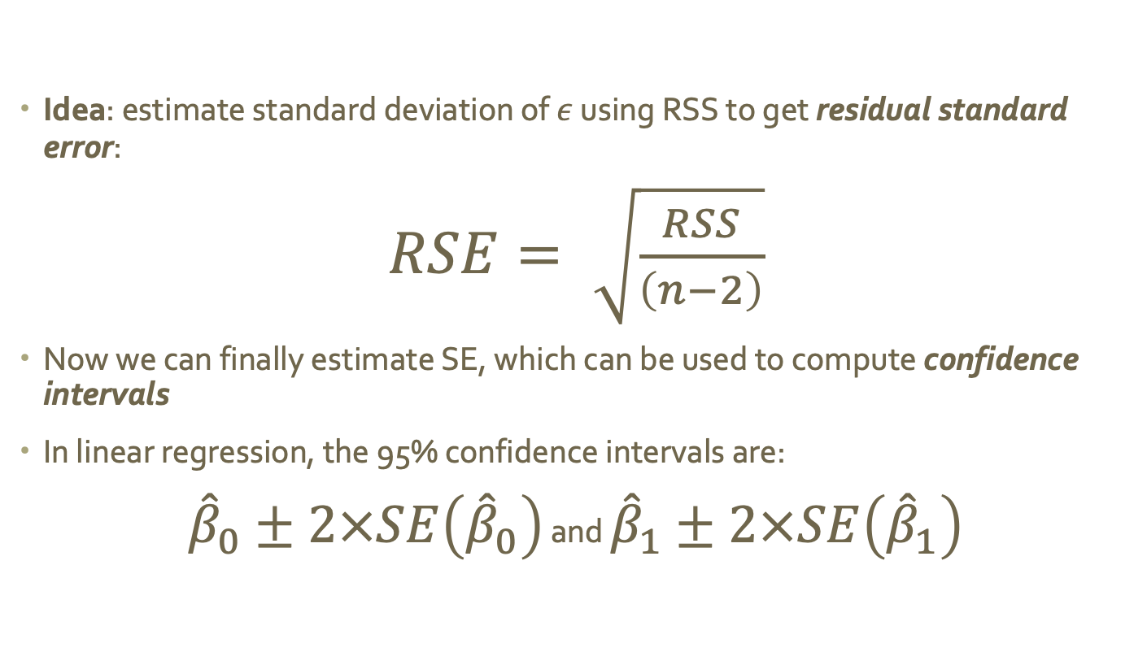
Residual standard error
Idea: estimate standard deviation of $ε$ using RSS to get residual standard error:
$RSE= \sqrt{\frac{RSS}{\left(n−2\right)}}$
Now we can finally estimate SE, which can be used to compute confidence intervals
In linear regression, the 95% confidence intervals are:
${\hat{β}}_{0}±2×SE\left({\hat{β}}_{0}\right)$ and ${\hat{β}}_{1}±2×SE\left({\hat{β}}_{1}\right)$
Notes:
Standard error can be used to compute confidence intervals, a range of values that we believe with some level of confidence contain the true value

Slide 28
Using SE for hypothesis testing
Goal: determine if sales are related to advertising budget
If there is NO relationship, what is the true value of $β_{1}$?
$$no relationship=no slope$$
$$β_{1}=0$$
To test: compute the probability that we observed our (estimated) $β_{1}$ by chance, assuming a true value of 0
If this probability is small, we say a relationship exists

Slide 29
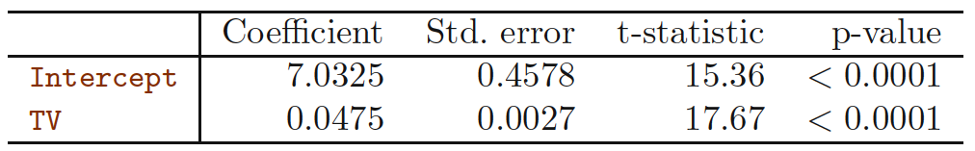
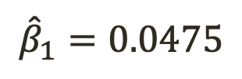
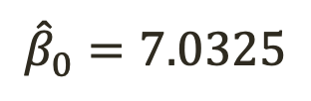
Advertising example
$${\hat{β}}_{0}=7.0325$$
$${\hat{β}}_{1}=0.0475$$

Slide 30
How good is this model?
RSE is (roughly) the amount the response will deviate from the true regression line
RSE is an absolute measure, given in the same units as the response variable
Question: how do you know what a “good” RSE is?
Notes:
Now that we know there is a relationship, we probably want to know how well the model captures it
We’ve seen one measure: RSE is (roughly) the amount the response will deviate from the true regression line
RSE is an absolute measure, given in the same units as the response variable
Question: how do you know what a “good” RSE is?

Slide 31
How good is this model?
Alternate approach: measure the proportion of variance explained by the model
$R^{2}$ is one such measure:
$$R^{2}=1−\frac{RSS}{\sum_{i=1}^{n}{{\left(y_{i}−\overline{y}\right)}^{2}}}$$
variance
not explained
after regression
total variance
in the response

Slide 32
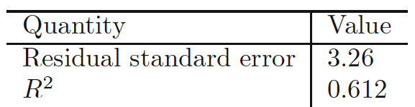
TV and sales
What does the RSE tell us?
What does $R^{2}$ tell us?

Slide 33
Discussion
Question: how could we handle
multiple predictors?
Notes:
So far, we’ve only talked about the effect of one variable
Question: how do we handle multiple predictors?

Slide 34
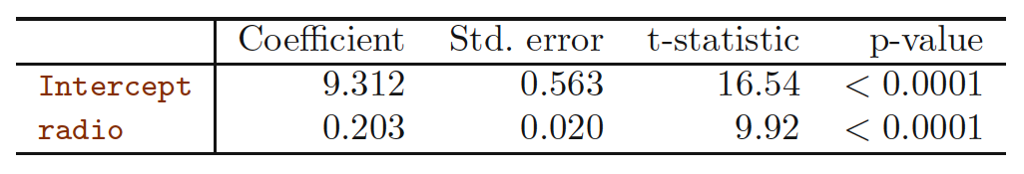
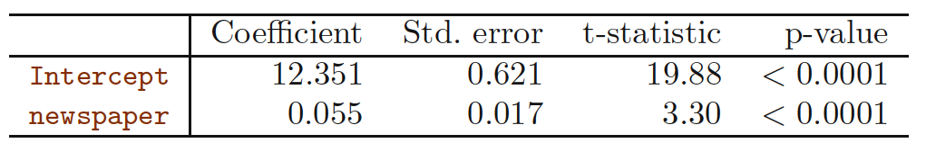
Option 1: SLR for each predictor
What problems do you see with this approach?

Slide 35
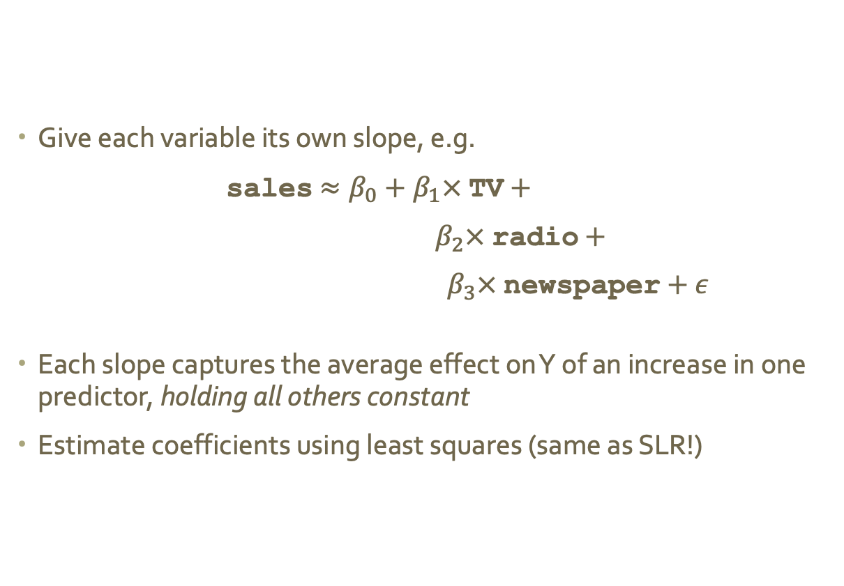
Option 2: extend the linear model
Give each variable its own slope, e.g.
sales $≈β_{0}+β_{1}× \text{TV}+$
$β_{2}×$ $\text{radio}$ $+$
$β_{3}×$newspaper$+ ε$
Each slope captures the average effect on Y of an increase in one predictor, holding all others constant
Estimate coefficients using least squares (same as SLR!)

Slide 36
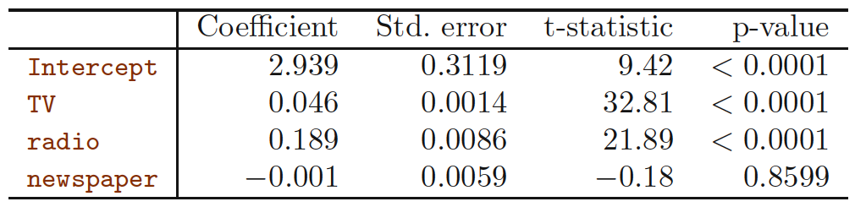
Advertising example
What does this tell us?
Do you notice anything unexpected?
Notes:
When we fit a MLR model to the advertising data, we get the following least-squares coefficients
What does this tell us? Anything unexpected?
Does it make sense for the MLR to indicate no effect of newspaper advertising on sales?
Does this match what we saw when we looked at radio alone?

Slide 37
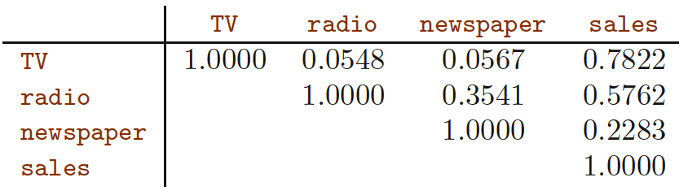
What happened to newspaper ads?
Let’s look at the correlation between all the dimensions
In SLR, newspaper spending was “getting credit”
for radio spending’s work!
Notes:
Let’s look at the correlation between all the dimensions

Slide 38
Questions we ask in MLR
Is at least one of the predictors useful in predicting the response?
Do all the predictors help to explain the response, or is only a subset of the predictors useful?
How well does the model fit the data?
Given some predictor values, what response should we predict, and how accurate is our prediction?

Slide 39
Q1: is at least one predictor useful?
SLR: test to see if the slope was 0 (no effect)
MLR: test whether ALL of the slopes are 0 (no effect)
To do this, we compute the F-statistic:
$$F=\frac{\left(TSS−RSS\right)}{p}×\frac{\left(n−p−1\right)}{RSS}$$
where p is the # of predictors and n is the sample size
Value close to 1 → no effect
Question: why look at the F-statistic and not just at the p-values for each predictor in turn? (hint: lots of predictors?)

Slide 40
Q2: do we need them all?
Now we know that at least one predictor has an effect: which one(s) is it?
Determining which predictors are associated with the response is referred to as variable selection
Some classic approaches:
Exhaustive search
Forward selection
Backward selection
Mixed selection
More detail in Ch. 6
Notes:
Now we know that at least one predictor has an effect: which one(s) is it?
Determining which predictors are associated with the response is referred to as variable selection
I’ll hint at some classic approaches today, and go into more detail when we get to Ch. 6

Slide 41
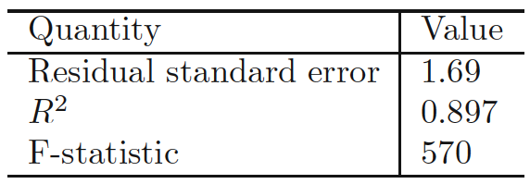
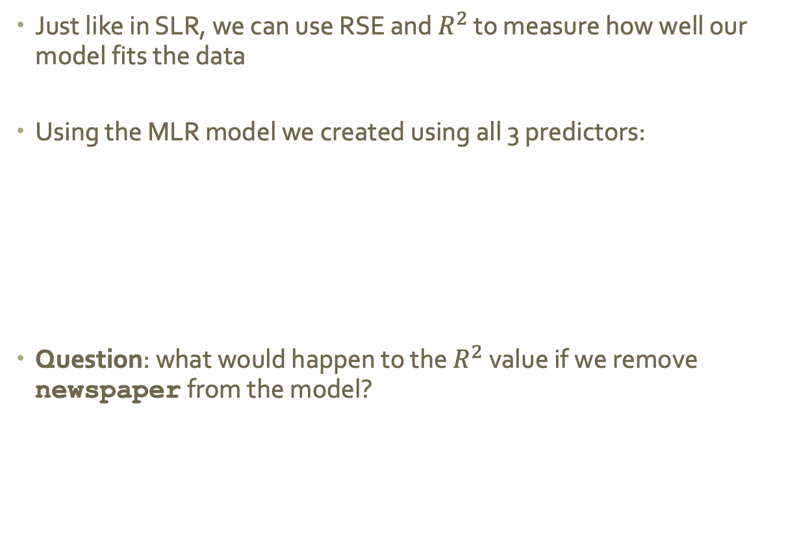
Q3: How well does the model fit the data?
Just like in SLR, we can use RSE and $R^{2}$ to measure how well our model fits the data
Using the MLR model we created using all 3 predictors:
Question: what would happen to the $R^{2}$ value if we remove newspaper from the model?

Slide 42
Q4: How confident are we?
Now that we have a model, making a prediction is a piece of cake (just plug and chug!)
Need to consider 3 kinds of uncertainty:
How far off are the coefficients? → confidence intervals
How far from linear is the true relationship? → ignore this for now
How much will any specific prediction vary from the true value, even if we had perfect coefficients? → prediction intervals

